Slide 1


Front-End Engineering-1 Project
Team Details:
Mohd. Arshad Malik -2210990580
Mohd. Ishaan-2210990581
Monalika-2210990582
Monu Kumar-2210990583
Faculty Cordinator: Dr.Renu Popli
Chitkara University Institute of Engineering and Technology,
Chitkara University, Punjab

Slide 2
Table of Contents
Case study
Introduction
Problem Statement
Technical Details
Key Features
Project Highlights
Conclusion
Reference/Links used

Slide 3
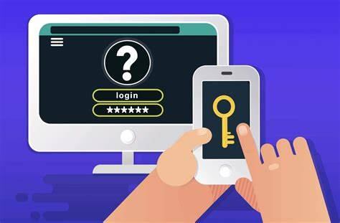
LOGIN-AUTHENTICATION

Slide 4
Introduction
The title of the project is “Login Authentication” and the team member’s names are:
Mohd. Arshad Malik,
Mohd. Ishaan,
Monalika
Mona Kumar

Slide 5
Understanding Login Authentication
When you try to access a protected Web resource, the Web container activates the authentication mechanism that has been configured for that resource. You can specify the following authentication mechanisms:
HTTP basic authentication
Form-based login authentication
Client certificate authentication
Mutual authentication
Digest authentication
If you do not specify one of these mechanisms, the user will not be authenticated.

Slide 6
CASE STUDY
1.Project Goals:
Develop a secure and reliable login authentication system.
Implement strong password policies and encryption techniques to safeguard user credentials.
Prevent unauthorized access and protect user accounts from brute-force attacks.
Provide a password recovery mechanism to assist users who forget their passwords.
2. System design
User Registration: A registration module where users can create new accounts by providing their personal details and creating a password.
Login Process: A login module that verifies user credentials against stored data and grants access to authorized users.
Password Security: Implementation of password policies, including complexity requirements, hashing, and salting techniques to protect stored passwords.

Slide 7
Account Lockout: Mechanism to lock user accounts temporarily after multiple failed login attempts within a specified time frame.
Password Recovery: Secure options for users to recover their passwords, such as email-based password reset links or security questions.
3. Results and Benefits:
The implementation of the login authentication system will significantly enhance the security of the e-commerce platform, protecting user accounts and sensitive data.
User confidence and trust in the platform will increase, leading to improved customer satisfaction and increased usage of the e-commerce services.

Slide 8
BRIEF OVERVIEW:
Login authentication is a vital process,vitally followed by organizations to keep their servers safe by allowing access only to authenticated users.
Every website or application demands users to complete the login authentication process to cement their credentials for security and to improve user experience.
It is to authenticate the credential that wishes to perform the activity,if the credential is matched,the process is completed and the user will be granted for the access.
In authentication, the user or computer has to prove its identity to the server.

Slide 9
Problem Statement
The problem statement of login authentication is to securely verify the identity of a user attempting to access a system, application, or online service. It involves the process of validating the credentials provided by the user, typically a combination of a username and password, to ensure that only authorized individuals can gain access while keeping unauthorized users out.
The key challenges in login authentication include:
Security: Ensuring that the authentication process is secure and resistant to various threats such as brute-force attacks, password guessing, and credential theft.
User Experience: Balancing security measures with a smooth and user-friendly login experience, minimizing the effort required for users to authenticate themselves without compromising security.

Slide 10
Authentication Factors: Considering different authentication factors, such as something the user knows (password), something the user has, or something the user is (biometric data), and determining the appropriate combination of factors based on the sensitivity of the system and user requirements.
Account Recovery: Implementing mechanisms for users to recover their accounts in case of forgotten passwords or compromised accounts, while maintaining a balance between security and ease of account retrieval.
Multi-factor Authentication (MFA): Providing support for additional layers of security, such as two-factor authentication (2FA) or multi-factor authentication (MFA), to add an extra level of protection beyond a simple username and password combination.
The goal of login authentication is to ensure that only authorized users can access the system while protecting user accounts and sensitive data from unauthorized access.

Slide 11
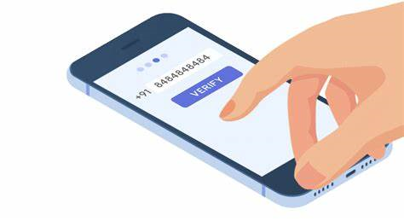
Technical Details
We will design a log in page using HTML and CSS.
A login page in HTML collects information from the user and log in button to send the details for server-side operations.
We will first create the simple structure with HTML and then move to make it look great with CSS.

Slide 12
Key Features
We can strengthen our user authentication by following methods:
User Registration: The ability for users to create an account and provide their login credentials, including a username and password.
Login Page: A login page where users can enter their login credentials to access the system or application.
Password Security: Strong password policies that enforce password complexity and expiration, preventing users from using easily guessed passwords and ensuring that passwords are changed regularly.
Password Recovery: The ability for users to recover their password if they forget it, such as through a password reset link sent to their email address or phone number.

Slide 13
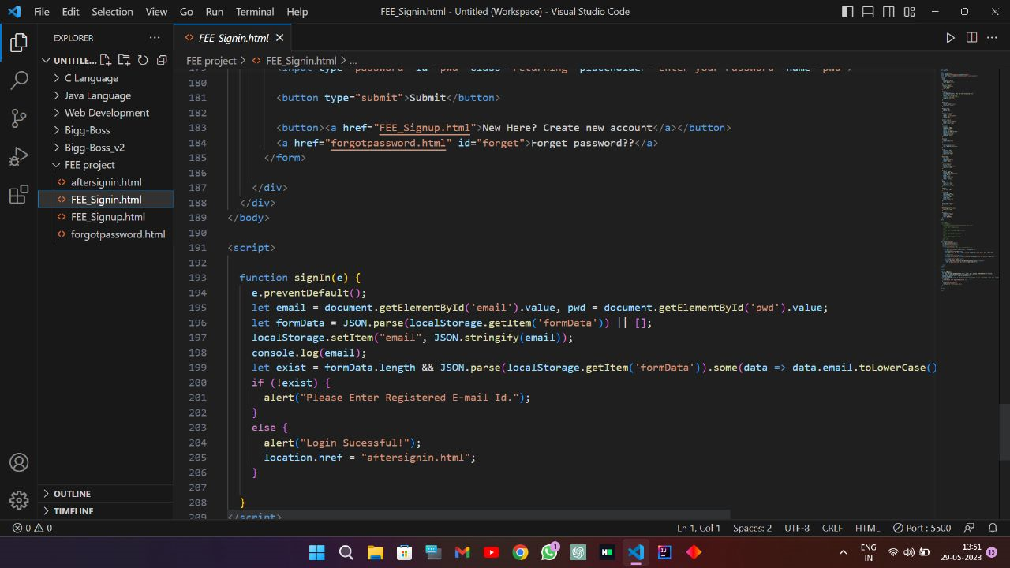
PROJECT HIGHLIGHTS

Slide 14
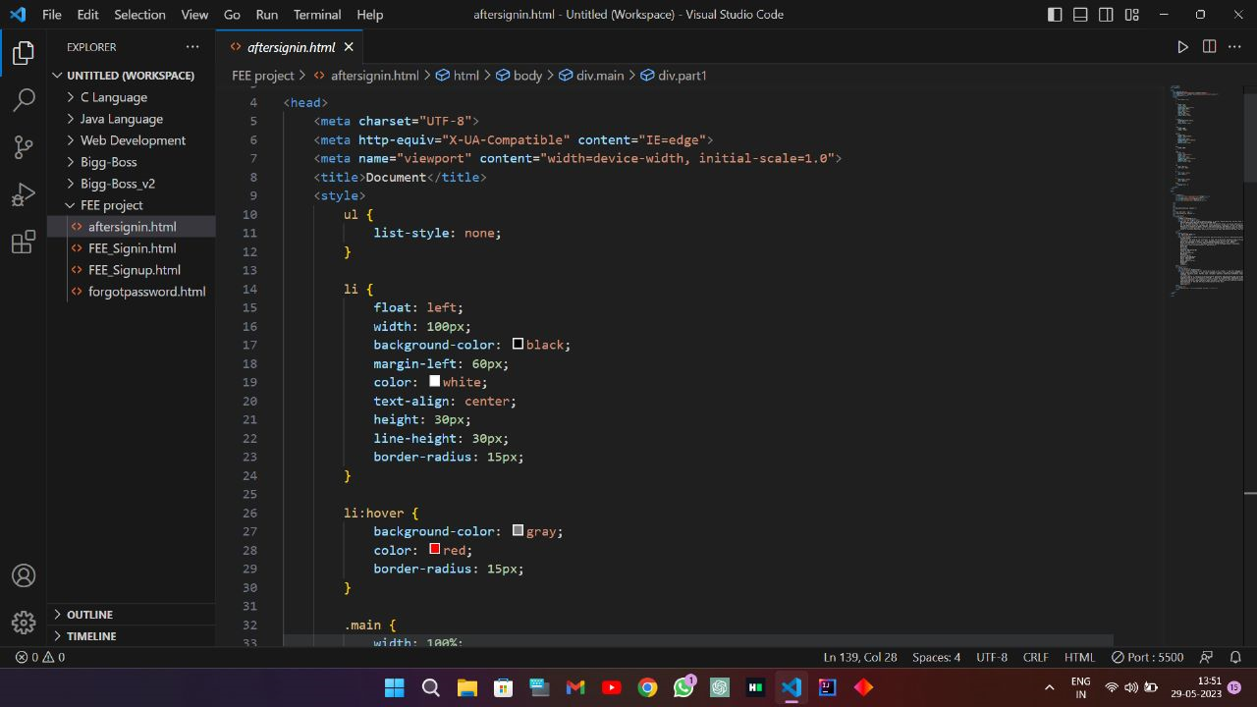

Slide 15
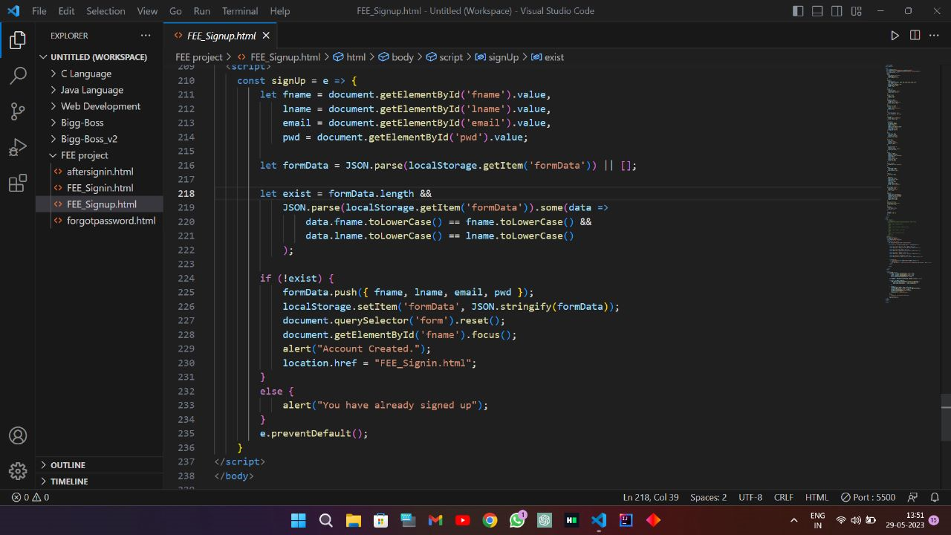

Slide 16
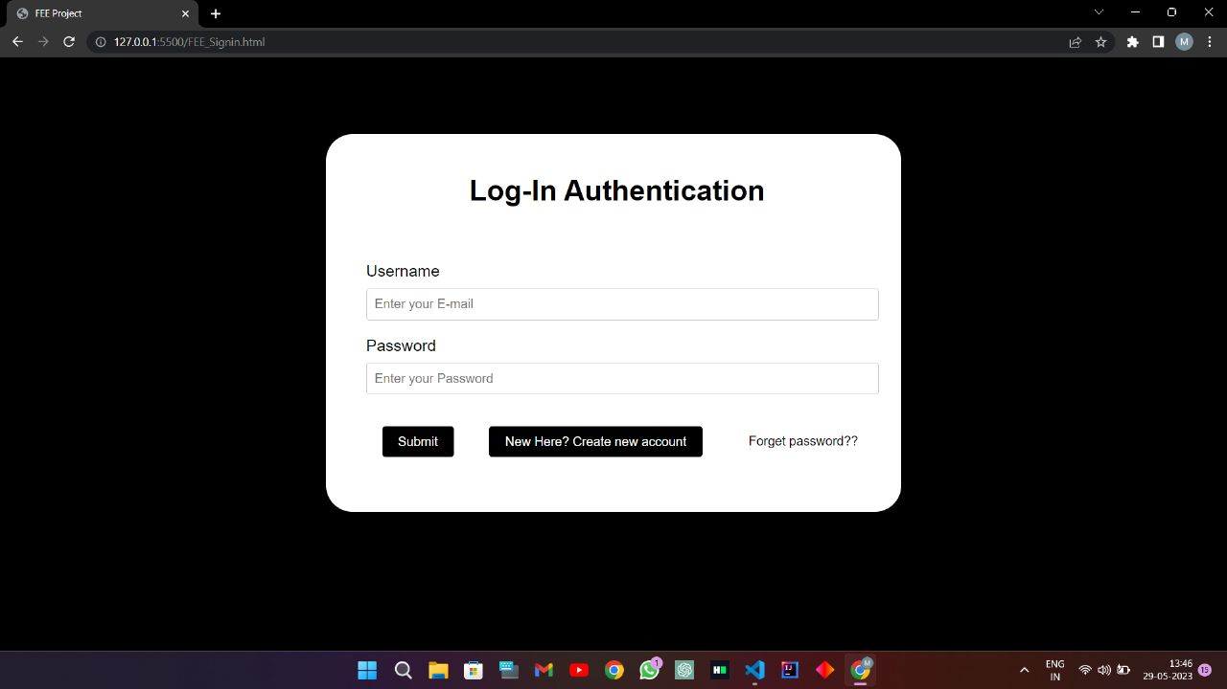
OUTPUT

Slide 17
Conclusion
The basic job of authentication is to manage the user identification and provide them with suitable access control.
For the security purposes,the login system also can be improved by ensuring the password of the user must be more than 8 characters and with the combination of upper and lower case, numbers and expression.

Slide 18
References/Links
https://eprints.utar.edu.my
https://swoopnow.com

Slide 19


